Slide 1


air
Tomorrow’s travel ecosystem today

Slide 2
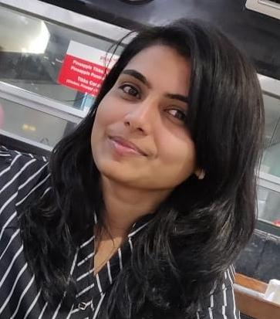
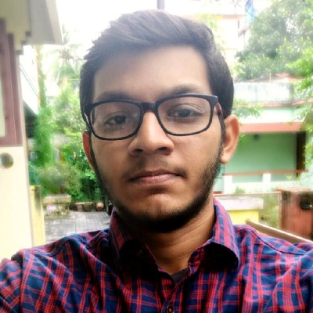
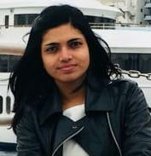
Team Blueprint
We provide ideas and strategies to disrupt airport ecosystem
AKSHATA KULKARNI
SOFTWARE DEVELOPER
TOMPSON REUTERS
SAURABH R NAYAK
SOFTWARE DEVELOPMENT ENGINEER
INTEL CORPORATION
VAISHNAVI KULKARNI
SOFTWARE VALIDATION ENGINEER
CAPGEMINI

Slide 3
Vision
Revolutionize the airport ecosystem for enhancing the customer experience by bringing digital transformations and expanding the amenities with more partners on board.

Slide 4

Pickup and drop
Transport partners
Entertainment offerings
Market breakthrough
Better planning and
trust
Subscription offerings
Tailored maps
Hassle free
airport
Higher sales
Partners growth and satisfaction
Silent airports
Traveler satisfaction
Baggage handling
Zero faults

Slide 5
Features
Pickup and drop off facilities
Increased sales in stores
Smoother functioning silent airports
Entertainment offerings
Well tailored maps
Improved baggage handling
Subscription based offerings

Slide 6


Pickup and drop off facilities
The customers always prefer a safe and assured journey right from the start. With flights scheduled from early morning to late nights, some people feel it difficult and uncomfortable to schedule a cab to reach airport or get to the required place from the airport.
Keeping the traveler’s perspective the solution we propose has to be trustworthy and also not too costly. With that is mind the best solution is to establish partnership with cab services through our Adani Air app. The app gives an easy to use dashboard for booking rides. Giving them promotional features with discounts to use the cab service will generate revenue for both parties. For cab company as there would be increased footfall, where as for Adani Air revenue will be generated through a commission based pay per travel and also as an advertiser and most importantly satisfied travelers.

Slide 7

Increased sales in stores
It’s a known fact that people don’t tend to purchase eateries and other commodities from airports as they tend to be costlier and than the regional price of the product. Major reason behind the increase of price in the airport is because retailers have high operating cost. Our solution is aimed in benefiting both parties.
Customers want more affordable or good deals on any product to pop it into their cart. So our aim is to create a partner ship between the airport stores and the airplane companies so that both can have a win-win situation. We aim at providing the customers increased discounts on the products and give them aircoins (shopping points) based on their purchases, these coins can be redeemed with the flight amenities like discounts on food/beverages or discounts on their next bookings.

Slide 8

Smoother functioning silent airports
Implementation of silent airport obviously has a good impact in the airport environment, but some customers do prefer an announcement based update. We in our app provide real-time updates on the timings and prompt the user with a notification automated call based on the severity of the updates.
We can also add an additional feature called get assist which if triggered by the customer will notify the airport guides nearby and give them the location of the customer to get to them for needed support.

Slide 9
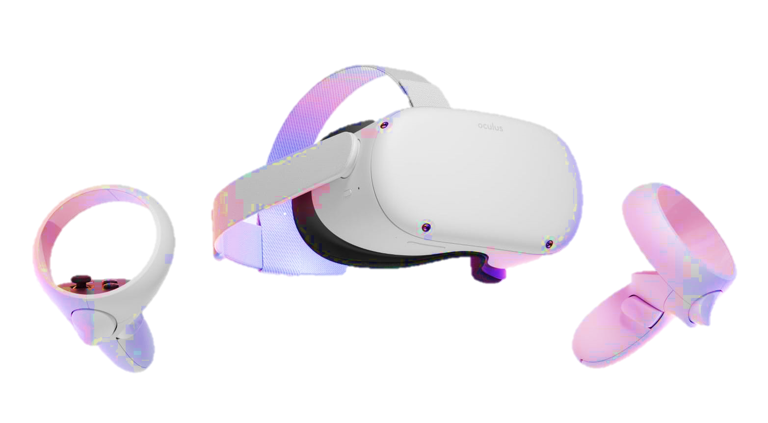
Entertainment offerings
Entertainment is a sector which is not yet well explored and has a huge market to capture on. There is a huge market in investing during the time of the travelers as they would be mostly idle through the journey and during the waiting period.
A partnership could be made with movie productions, other entertainment industries, depending on a criteria like ticket class or addons travelers could be given some exclusive content. This would imprint a good experience post journey.
Another opportunity to explore could be to partner with Augmented reality companies and flight companies to get a live or near real time feed of the arial view. We can also integrate advertising contents and generate income in this feature.

Slide 10
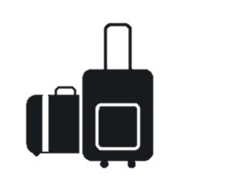

Improved baggage handling
Baggage handling is a major component in customer satisfaction. We can see some cases where the baggage gets misplaced and gets unloaded in other airport. However low the number of these cases be, even one of such cases gives some serious damage to the airlines reputation.
We can make it failproof by making technology play its role well. As of now we have barcode based tags that are scanned during loading and unloading. We will be introducing RFID based reusable tags instead of barcodes. In every point of baggage transition we would be having RFID reader device to which confirms if the baggage is being misplaced, and as the RFID tags have a higher scan range as compared to barcode, the process would be smooth with minimal manual scans.

Slide 11

Well tailored maps
Getting directions in bigger airports can be sometimes difficult, even though we have static maps and volunteers to help us get to a point. By implementing a tailored resource for the traveler for his journey on his finger tips, is the solution we need to give.
We provide the traveler best routes and ride guides from his/her residence to the airport by integrating with google maps API’s. Once reached the airport they will have an Augmented Reality based direction provider to get wherever they want within the airport. Some common routes and the traveler specific gates would be provided as a quick find option. This would make the travelers journey hassle free.

Slide 12

Subscription based offerings
Travelers can be divided as seasonal or frequent travelers depending on their job profiles or needs. As of now we are not tapping the opportunity to make their lives better and also revenue generations from the premium travelers.
Subscription models allows them to get a tailored service as they want for every trip they take without them wanting to select services on every trips individually. It will also be giving them discounts and premium services at lower cost. By gaining more subscribers our company can take better future decisions on investments as a portion of audience and their needs are known, also it would increase the trust of our investors and partners to increase their business contracts with us.

Slide 13
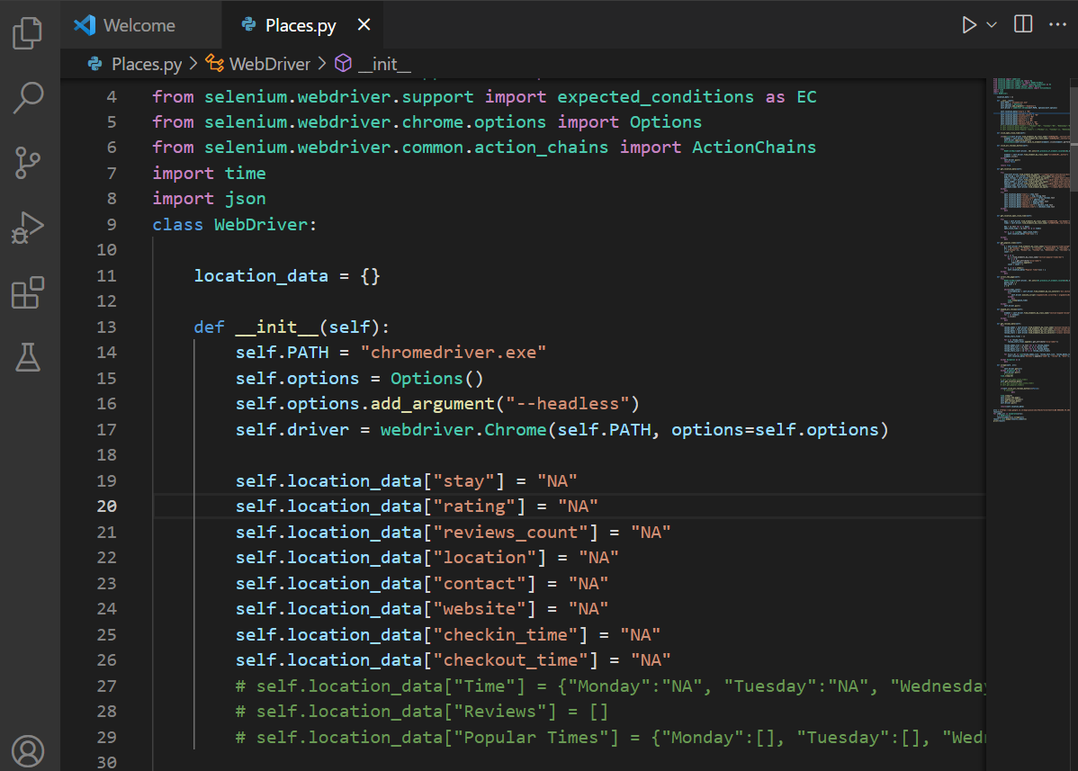
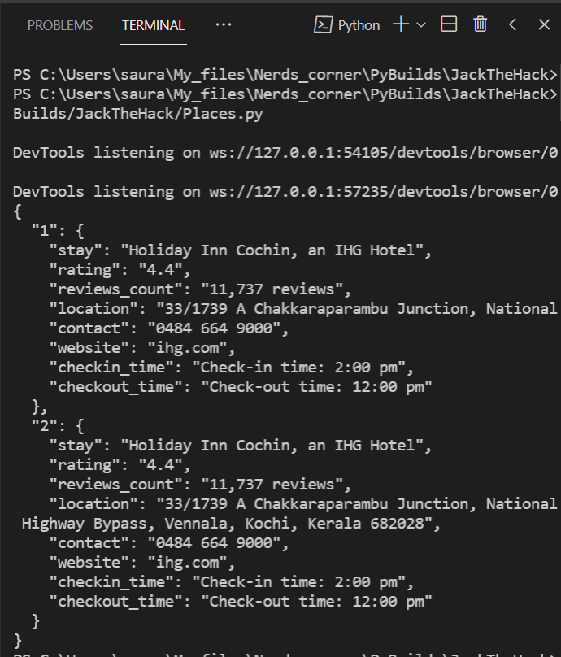
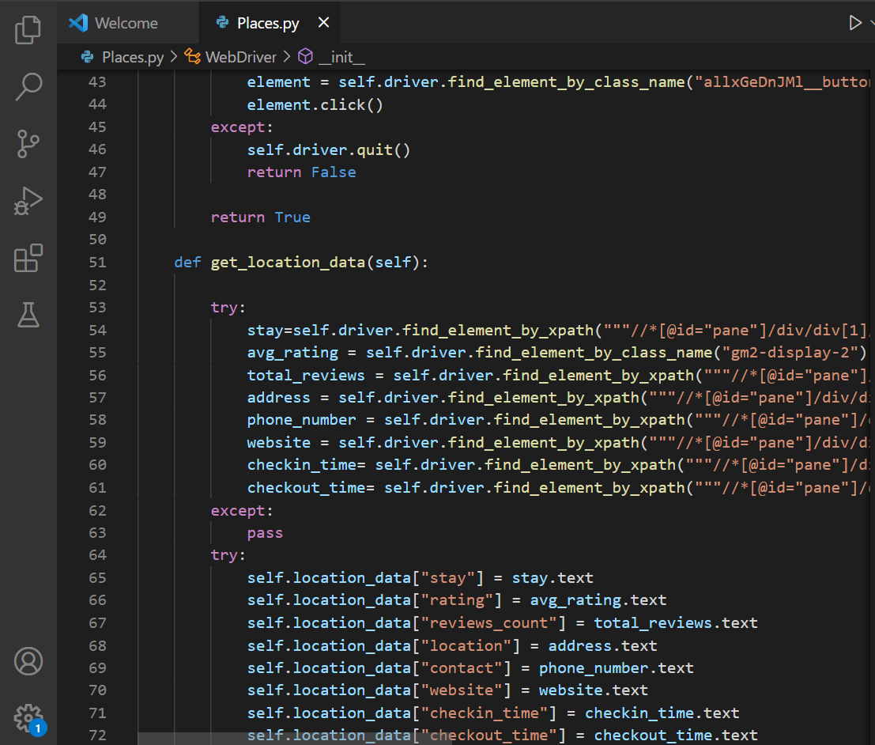
Screenshots of tailored stay suggestions
Find the whole code in github repo

Slide 14
Actions can be disruptive only with innovative minds, with an opportunity we promise to bring the change ..
FIN

